Slide 1
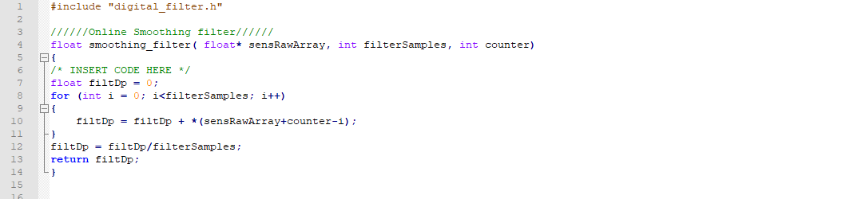
Introduction to Robotics and Mechatronics
GROUP 2.5
Benson Chalethu
Pietro Griffa
Ingvar Groza
PreLab 04
Q1
Q2

Slide 2
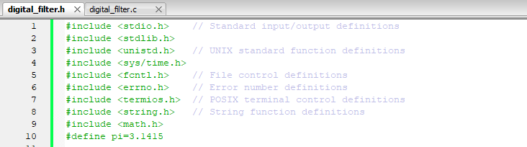
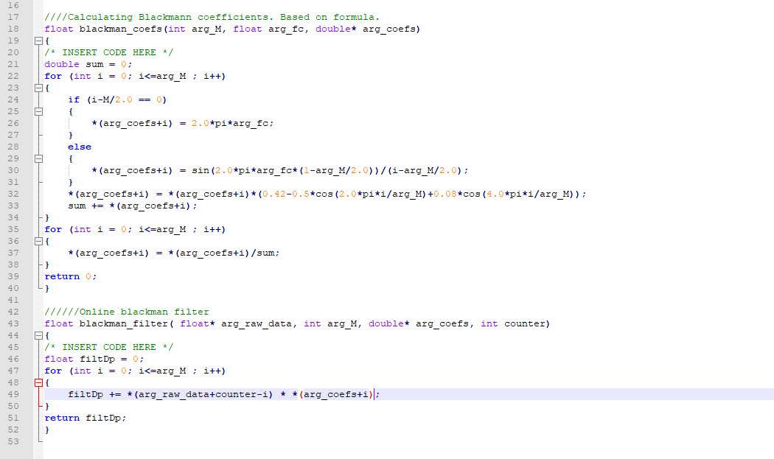
Q3

